Slide 1
Hiring Process Analytics
Name :- Yash Shinde
Email :- yashpradeepshinde@gmailcom

Slide 2
TABLE OF CONTENT
Project Description
Approach
Tech Stack Used
Analysis
Hiring Analysis
Salary Analysis
Salary Distribution
Department Analysis
Position Tier Analysis
Insights
Conclusion & Result

Slide 3
PROJECT DESCRIPTION

Slide 4
PROJECT DESCRIPTION
This project involves Data Analysis for Hiring Process Optimization at a Multinational Company.
The hiring process is a pivotal aspect of any successful organization, and a renowned multinational company like Google, recognizes the significance of optimizing this process.
As a data analyst, I have been tasked with conducting a comprehensive data analysis of the company's hiring process.
My primary objective is to extract meaningful insights and actionable recommendations that will facilitate the company in conducting recruitment procedures and making well-informed decisions for future hiring endeavors.
In this project, I will be provided with a dataset containing detailed records of previous hires at company. The dataset encompasses essential information, such as candidate demographics, interview details, job types and other relevant hiring metrics.
Leveraging my expertise in data analysis, I will perform A Data-Driven Analysis of Enhancing Hiring Process Efficiency.

Slide 5
approach

Slide 6
approach
Firstly, go through the dataset to know more about the data, tables, columns and the rows.
Analyze the data given in the dataset to perform operations.
Then solve the questions using Excel formulas.
I will provide a detailed explanation of output along with the formula and visual charts & graphs.
I will perform my analysis using the following list of points.
Analysis
Hiring Analysis
Salary Analysis
Salary Distribution
Department Analysis
Position Tier Analysis

Slide 7
Tech stack used
Microsoft Excel
Microsoft PowerPoint

Slide 8
analysis
Hiring Analysis
Salary Analysis
Salary Distribution
Department Analysis
Position Tier Analysis

Slide 9
A. hiring analysis: The hiring process involves bringing new individuals into the organization for various roles. Let's Determine the gender distribution of hires. How many males and females have been hired by the company?
For finding total number of males and females have been hired by the company.
I first filtered the status column by selecting hired candidates.
Then filtered the “event_name” column by selecting Male and Female
Then created a bar chart on that to analyze the result.
event_name | Count of event_name
Female | 1856
Male | 2563

Slide 10
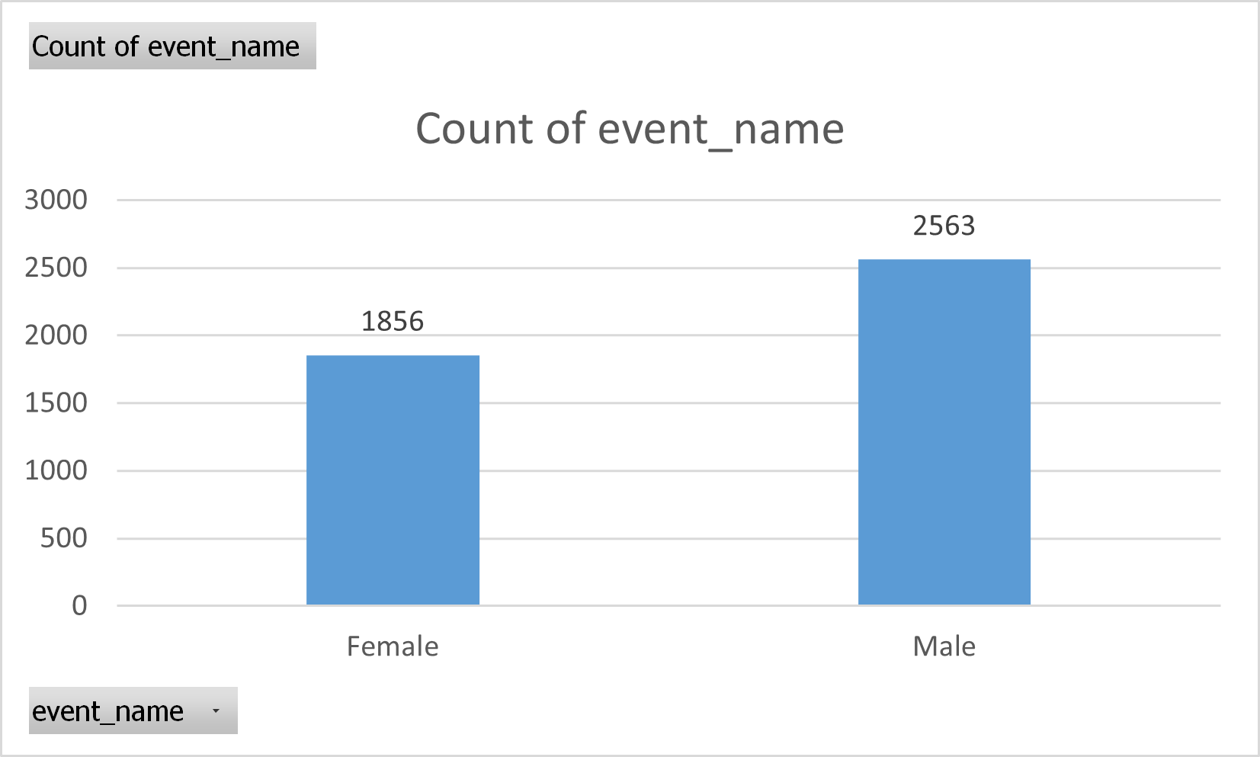

Slide 11
Average Salary : Adding all the salaries for a select group of employees and then dividing the sum by the number of employees in the group.
Steps to find the average salary offered in this company:-:
Step 1) I have removed outliers from the dataset.
( i.e. Salaries below 500 and Salaries above 100000)
Step 2) Then by using the “AVERAGE” formula of excel I have calculated the average salary.
Excel Formula :
=AVERAGE(G2:G7164)
Output/Result :
average_salary = | 49885.28117

Slide 12
Salary Distribution: Class intervals represent ranges of values, in this case, salary ranges. The class interval is the difference between the upper and lower limits of a class. Create class intervals for the salaries in the company. This will help you understand the salary distribution.
Steps to find the salary distribution offered in this company:-:
Step 1) I have selected “application id” and “offered salary” columns from the entire data.
Step 2) Then by selecting those columns created pivot table.
Step 3) Then grouped salaries by stepping of 5000.

Slide 13
Row Labels | Count of application_id
1-5000 | 295
5001-10000 | 382
10001-15000 | 360
15001-20000 | 372
20001-25000 | 348
25001-30000 | 363
30001-35000 | 331
35001-40000 | 379
40001-45000 | 414
45001-50000 | 367
50001-55000 | 388
55001-60000 | 362
60001-65000 | 340
65001-70000 | 358
70001-75000 | 348
75001-80000 | 386
80001-85000 | 356
85001-90000 | 355
90001-95000 | 325
95001-100000 | 334
Grand Total | 7163

Slide 14
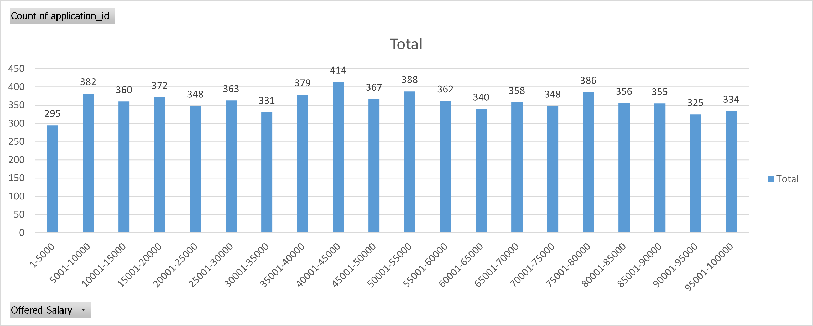

Slide 15
Departmental Analysis: Visualizing data through charts and plots is a crucial part of data analysis. Use a pie chart, bar graph, or any other suitable visualization to show the proportion of people working in different departments.
Steps to perform departmental analysis:
Step 1) I have selected “application id” and “Department” columns from the entire data.
Step 2) Then by selecting those columns created pivot table.
Step 3) Then grouped salaries by stepping of 5000.
Excel Formula :
=AVERAGE(G2:G7164)
Output/Result :
average_salary = | 49885.28117

Slide 16
Throughput Analysis : Create an SQL query to calculate the 7-day rolling average of throughput. Also, explain why you prefer using the daily metric or the 7-day rolling average for throughput.
Output/Result Table :
review_date | jobs_reviewed | rolling_average_throughput_7days
11/25/2020 | 1 | 1
11/26/2020 | 1 | 1
11/27/2020 | 1 | 1
11/28/2020 | 2 | 1.25
11/29/2020 | 1 | 1.2
11/30/2020 | 2 | 1.3333

Slide 17
Language Share Analysis: Calculate the percentage share of each language in the last 30 days. Write an SQL query to calculate the percentage share of each language over the last 30 days.
Steps for finding the percentage share of each language :
Step 1) I have selected `operation & metric analytics` database for accessing data.
Step 2) Then I created a temporary table (i.e. Common Table Expression) named language_total.
In that table, I have counted total number of occurrences of each language as “total” from “job_data” table and grouped them using the “language” column.
Step 3) Then I used that temporary table in the following command for calculation of percentage. Step 4) Formula used for percentage is “(total / (SELECT COUNT(*) FROM job_data)) * 100”
Query/Program :
with language_total as (
select job_id, language,
count(language) as total
from job_data
group by language)
SELECT
job_id, language, total,
(total / (SELECT COUNT(*) FROM job_data)) * 100 AS percentage
FROM
language_total;

Slide 18
Language Share Analysis: Calculate the percentage share of each language in the last 30 days. Write an SQL query to calculate the percentage share of each language over the last 30 days.
Output/Result Table :
job_id | language | total | percentage
21 | English | 1 | 12.5
22 | Arabic | 1 | 12.5
23 | Persian | 3 | 37.5
25 | Hindi | 1 | 12.5
11 | French | 1 | 12.5
20 | Italian | 1 | 12.5

Slide 19
Duplicate Rows Detection: Identify duplicate rows in the data. Write an SQL query to display duplicate rows from the job_data table.
Steps for finding the duplicate rows :
Step 1) I have selected all columns from “job_data” table where all columns are present in the same table which is selected using the derived table and ‘IN’ command.
Step 2) Then I created a derived table which has all columns grouped by all columns from table “job_data” as we want to check if there is any duplicate row in the table.
Step 3) Then by using “HAVING COUNT(*)>1” we have selected only those rows which are duplicate.
Step 4) In table job_data there are no duplicate rows so we get empty table as output.
Query/Program :
SELECT *
FROM job_data
WHERE (ds, job_id, actor_id, event, language, time_spent, org) IN (
SELECT ds, job_id, actor_id, event, language, time_spent, org
FROM job_data
GROUP BY ds, job_id, actor_id, event, language, time_spent, org
HAVING COUNT(*) > 1
);

Slide 20
Duplicate Rows Detection: Identify duplicate rows in the data. Write an SQL query to display duplicate rows from the job_data table.
Output/Result Table :
ds | job_id | actor_id | event | language | time_spent | org
In the job_data table there are no duplicate rows, so we get an empty table as output.

Slide 21
Weekly User Engagement: Objective: Measure the activeness of users on a weekly basis. Your Task: Write an SQL query to calculate the weekly user engagement.
User Growth Analysis:
Objective: Analyze the growth of users over time for a product.
Your Task: Write an SQL query to calculate the user growth for the product.
Weekly Retention Analysis:
Objective: Analyze the retention of users on a weekly basis after signing up for a product.
Your Task: Write an SQL query to calculate the weekly retention of users based on their sign-up cohort.
Weekly Engagement Per Device:
Objective: Measure the activeness of users on a weekly basis per device.
Your Task: Write an SQL query to calculate the weekly engagement per device.
Email Engagement Analysis:
Objective: Analyze how users are engaging with the email service.
Your Task: Write an SQL query to calculate the email engagement metrics.

Slide 22
Weekly User Engagement: Measure the activeness of users on a weekly basis. Write an SQL query to calculate the weekly user engagement.
Investigating Metric Spike
Steps for finding the weekly user engagement :
Step 1) I have selected `operation & metric analytics` database for accessing data.
Step 2) I have extracted week number from “occurred_at” column using the WEEK function as week_number.
Step 3) Then I counted the number of distinct user_id from the events table using COUNT function.
Step 4) By using GROUP BY clause grouped distinct user ids in each week. As we want to measure the activeness of users on a weekly basis.
Query/Program :
SELECT
WEEK(occurred_at) AS week_number,
COUNT(DISTINCT user_id) AS active_users
FROM events
GROUP BY week_number
ORDER BY week_number ;

Slide 23
Output/Result Table :
week_number | active_users
17 | 663
18 | 1068
19 | 1113
20 | 1154
21 | 1121
22 | 1186
23 | 1232
24 | 1275
25 | 1264
26 | 1302
27 | 1372
28 | 1365
29 | 1376
30 | 1467
31 | 1299
32 | 1225
33 | 1225
34 | 1204
35 | 104

Slide 24
User Growth Analysis: Analyze the growth of users over time for a product. Write an SQL query to calculate the user growth for the product.
Investigating Metric Spike
Steps for finding the user growth analysis :
Step 1) User growth of users over time for a product means a number of users signed up over time.
Step 2) I have extracted rows from table “events” where (event_name = "complete_signup") which gives us the entries for only user signups from all the events from events table.
Step 3) Then I have created an derived table named weekly signup to count the total number of sign ups each week.
Step 4) Then by using SELECT command on the table weekly_signup. I have created a new table where I have added new table named “cumulative_signup”.
Step 5) To calculate cumulative signup I have used an window function “OVER()”.

Slide 25
User Growth Analysis: Analyze the growth of users over time for a product. Write an SQL query to calculate the user growth for the product.
Query/Program :
with signup as(
select occurred_at, event_name from events where event_name = "complete_signup")
SELECT
week_number,
total_signup,
SUM(total_signup) OVER (ORDER BY week_number) AS cumulative_signup
FROM
(SELECT
WEEK(occurred_at) AS week_number,
COUNT(event_name) as total_signup
FROM signup
GROUP BY week_number
ORDER BY week_number) as weekly_signup;

Slide 26
Output/Result Table :
week_number | total_signup | Cumulative_signup
17 | 72 | 72
18 | 163 | 235
19 | 185 | 420
20 | 176 | 596
21 | 183 | 779
22 | 196 | 975
23 | 196 | 1171
24 | 229 | 1400
25 | 207 | 1607
26 | 201 | 1808
27 | 222 | 2030
28 | 215 | 2245
29 | 221 | 2466
30 | 238 | 2704
31 | 193 | 2897
32 | 245 | 3142
33 | 261 | 3403
34 | 259 | 3662
35 | 18 | 3680
This data clearly shows us user growth for the product is constantly increasing.
That is shown graphically in the next slide through the bar chart on the week_number and Cumulative_signup column.

Slide 27
Output/Result Table :

Slide 28
Weekly Retention Analysis: Analyze the retention of users on a weekly basis after signing up for a product. Write an SQL query to calculate the weekly retention of users based on their sign-up cohort.
Investigating Metric Spike
Query/Program :
with activities as(
select occurred_at, event_name from events )
SELECT
week_number,
total_activities,
SUM(total_activities) OVER (ORDER BY week_number) AS cumulative_activities
FROM
(SELECT
WEEK(occurred_at) AS week_number,
COUNT(event_name) as total_activities
FROM activities
GROUP BY week_number
ORDER BY week_number) as weekly_activities;

Slide 29
Output/Result Table :
week_number | total_activities | cumulative_activities
17 | 8091 | 8091
18 | 17504 | 25595
19 | 17409 | 43004
20 | 18087 | 61091
21 | 17334 | 78425
22 | 18609 | 97034
23 | 18476 | 115510
24 | 19281 | 134791
25 | 18849 | 153640
26 | 19262 | 172902
27 | 20103 | 193005
28 | 20991 | 213996
29 | 20288 | 234284
30 | 21771 | 256055
31 | 18749 | 274804
32 | 16857 | 291661
33 | 16406 | 308067
34 | 16386 | 324453
35 | 802 | 325255
This data clearly shows us user retention is increasing.

Slide 30
Weekly Engagement Per Device: Measure the activeness of users on a weekly basis per device. Write an SQL query to calculate the weekly engagement per device.
Investigating Metric Spike
Steps for finding the weekly engagement per device :
Step 1) I have selected `operation & metric analytics` database for accessing data.
Step 2) I have extracted week number from “occurred_at” column using the WEEK function as week_number.
Step 3) Then I counted the number of distinct user_id from the events table using COUNT function.
Step 4) By using WHERE clause selected event_type as ‘engagement’.
Step 5) Finally combined the result using the GROUP BY clause on week_num and device.
Query/Program :
SELECT
week(occurred_at) as week_num,
device,
COUNT(distinct user_id) as no_of_users
FROM
events
where event_type = 'engagement'
GROUP by week_num, device
order by week_num;

Slide 31
Weekly Engagement Per Device: Measure the activeness of users on a weekly basis per device. Write an SQL query to calculate the weekly engagement per device.
Investigating Metric Spike
Output/Result Table :
Output has 492 rows thus I have provided the output csv file in the following drive link.
Drive Link:-
https://drive.google.com/file/d/1vZ5FddRzskdvGVb0qUUvbh5-N7eKAI6E/view?usp=sharing

Slide 32
Email Engagement Analysis: Analyze how users are engaging with the email service & Write an SQL query to calculate the email engagement metrics.
Investigating Metric Spike
Steps for finding the weekly engagement per device :
Step 1) I have selected `operation & metric analytics` database for accessing data.
Step 2) Then I have classified the actions into three categories: email_sent, email_opened, and email_clicked.
Step 3) That categorization will be performed using the CASE, WHEN, THEN functions.
Step 4) Then, I have calculated the email_opening_rate by summing up the occurrences of email_opened events and dividing the result by the sum of email_sent events. The final value is multiplied by 100.0 to represent the percentage accurately.
Step 5) Similarly, I have computed the email_clicking_rate by summing up the occurrences of email_clicked events and dividing the result by the sum of email_sent events. The outcome will also be multiplied by 100.0 to express the rate as a percentage.

Slide 33
Investigating Metric Spike
Query/Program :
SELECT
100.0 * COUNT(CASE WHEN email = 'email_opened' THEN 1 END) / COUNT(CASE WHEN email = 'email_sent' THEN 1 END) AS email_opening_percentage,
100.0 * COUNT(CASE WHEN email = 'email_clicked' THEN 1 END) / COUNT(CASE WHEN email = 'email_sent' THEN 1 END) AS email_clicking_percentage
FROM (
SELECT
*,
CASE
WHEN action IN ('sent_weekly_digest', 'sent_reengagement_email') THEN 'email_sent'
WHEN action IN ('email_open') THEN 'email_opened'
WHEN action IN ('email_clickthrough') THEN 'email_clicked'
END AS email
FROM
email_events
) email_action;
Output/Result Table :
email_opening_percentage | email_clicking_percentage
33.58339 | 14.78989

Slide 34
Conclusion

Slide 35
Conclusion
Thus, I have explored provided Job data and Investigated metric spike analytics.
Given all the required insights into the Marketing and Investees Matrices.
I have learned to handle the database on the MySQL Workbench.
I have learned to gain insights by using Queries.
All the respective queries and their output is attached to this report.
GitHub Repository and drive links are given as follows.
GitHub Repository:- https://github.com/ShindeYash/Operation_and_Metric_Analytics.git
Drive Link:- https://drive.google.com/drive/folders/1AG1LqrLAbPbGbaLKe0rd3Cpz24Ndh9w9?usp=sharing

Slide 36
THANK YOU
Yash Shinde​
yashpradeepshinde@gmail.com

